Slide 1
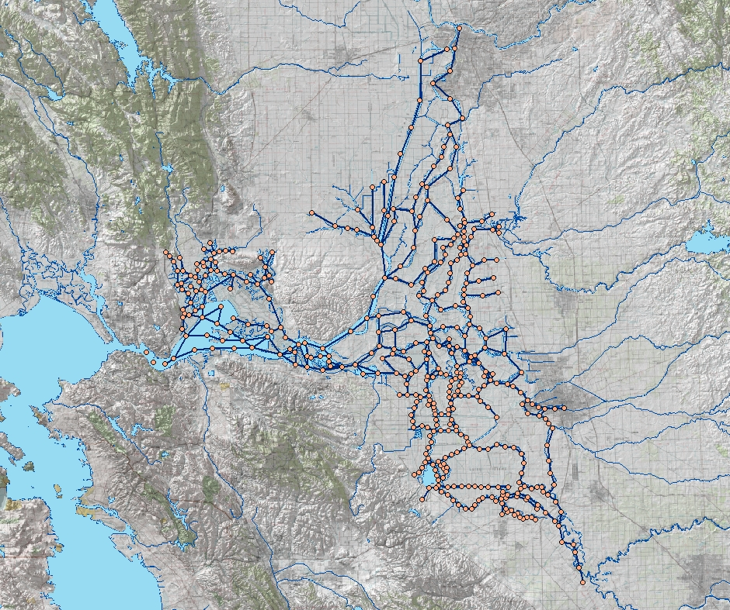
Reservoirs in DSM2 Delta Application
Sacramento
1. Clifton Court Forebay
2. Mildred Island
3. Bethel Island
4. Frank’s Tract
5. Discovery Bay
3
4
Martinez
2
5
Stockton
1
Image from USBR GIS Group

Slide 2
Gates in DSM2 Delta Application
1. Delta Cross Channel
Connected to channel
Connected to reservoir
2. Goodyear Slough
3. Morrow Island Intake
4. Morrow Is. C-line outfall
5. Morrow Is. M-line outfall
6. Roaring River Sl. Intake
7. Montezuma Slough
salinity control gate
Sacramento
1
8. 7-Mile Sl. @ 3-Mile Sl.
9. 7-Mile Sl. @ SJR
10. Sandmound Slough
3
5
4
6
7
8
9
2
Temporary Barriers
11. Middle River
12. Grant Line Canal
13. Old River at Tracy.
14. Head of Old River
Martinez
10
Stockton
11
15. Tom Paine Slough
16. Paradise Cut Weir
17
12
14
13
15
16
17. Clifton Court Forebay
Image from USBR GIS Group

